Slide 1














Objectives
Future Plans
How will we achieve this?
To develop a scalable AI chatbot application that diagnoses people with a disease, illness or a sickness. (now you can get diagnosed without leaving the house and you don’t have to call ANYONE)
Why? To help the understaffed NHS they need our help and we can help anyway we can.
Accessible to lots of demographics, ages, disabilities.
Phase 1
Business plan
Phase 2
Start design of our project
Learn skills required
Phase 3
Agile devlopment
By:
Owain Dutfield: 30026487
Kimmon Hlongwane :30023283
Ben Sarak Jones: 30030434
Zsolt Toldi: 30047627
Collaboration spaces (GitHub, teams, Trello)
Communication
Teamwork

Slide 2


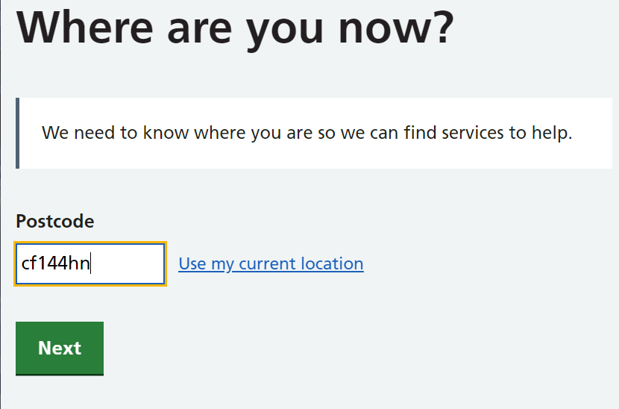
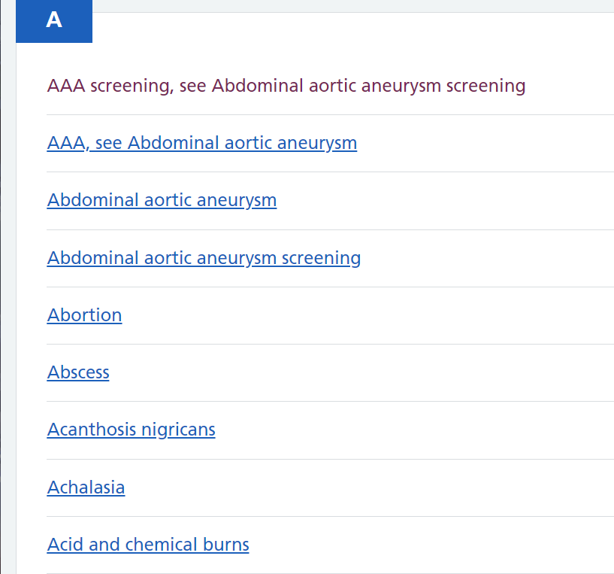
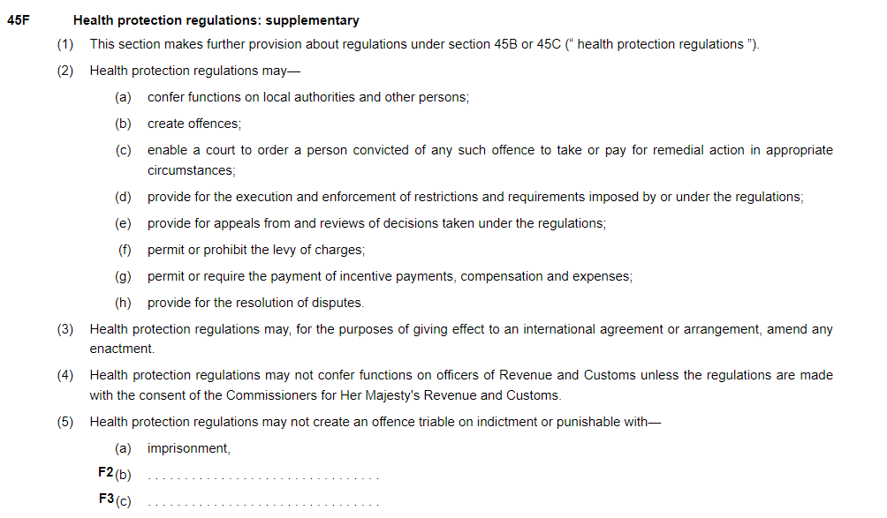
Ethics
LEPSI and Competiton
Regulatory agencies for medicine (The medicines and healthcare products regulatory agency) This body regulates devices which our application comes under the definition of.
Power of these agencies comes from acts such as the 1984 public health act, this act is where most of the emergency powers for covid came from before the 2020 covid act.
Liability if something goes wrong
Yellow card scheme
Intended use
Why Is Medical Ethics Important?
Four Pillars of Medical Ethics
The four pillars of medical ethics are:
Beneficence (doing good)
Non-maleficence (to do no harm)
Autonomy (giving the patient the freedom to choose freely, where they are able)
Justice (ensuring fairness)
HealthWeb Solutions created the NHS symptom checker
It works by narrowing down symptoms over a variety of questions
Weaknesses of the app
Strengths of the app

Slide 3

Technical Plan
Neural Network
What exactly is a neural network ?
How Tensorflow works ?
Tensorflows direct framework is tensors. Tensors are vectors or matrixes of n dimensions representing types of data. All the operations are made in a graph setting the graph for computation. When an operation has taken place it is known as an open node. Tensorflow will allow us to see how data moves through a graph or series of open nodes Each node that has been created is a muti-dimensional data array.
How we will implement Tensorflow in Python
Step 1: Import Tensorflow Library
Step 2: Use Tensorflow to interpret data-sets and an array of values.
Step 3:Add learnable parameters.
Step 4: Redefine the network by training it adding useful data to find the correct values for weight and biasness.
Step 5: Train the network
Step 6: Test network against a set up data.
How will be implementing the Neural Network ?
We will be using tensorflow to create the neural network.
What is Tensforflow ?
Tensorflow is an end-to-end platform, open-source library used to create large scale machine learning applications. It is used to acquire data, train models, solving predictions and refining future results.

Slide 4
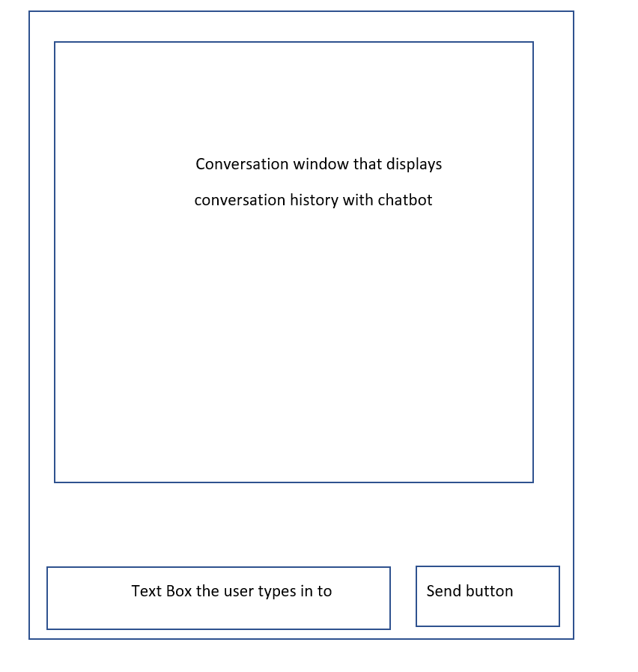


GUI
Our chosen Python GUI library
Our reasons for choosing Tkinter
One of the most popular GUI libraries for Python.
Cross platform compatibility
Good documentation
Simple and stable
KISS (Keep it simple stupid!)
Simple and Understandable Interface
Tkinter

Slide 5
Quality Asurance
Quality of Information
Accurate language translation for multiple Languages that will be provided to accommodate non-English users
Keeping in touch with the users
Updating the Application
Providing the right security and technical conditions for the user
Staying in touch with the User
User will be allowed to give feedback at the end of the conversation by filling a short feedback form.
Accurate language translation
Quality of Information
Through thorough research we will provide accurate information about diseases, injuries.
The company has set up meetings with qualified doctors to make sure we provide the most accurate information possible to the user.
At the end of a conversation the user will also be given the chance to speak to a real doctor if the application finds this the best option for user.
Providing the right security
Under GDPR the company has ensured that there is a data processing agreement that is set for any data that will be processed.
Frequent updates

Slide 6
Q&A
Any Questions?

Slide 7
Slide 1 references
dookam1/Professionalism-Group-Project: Group Project for professionalism and employability (github.com)
https://www.microsoft.com/en/microsoft-teams/log-in
Proffesionalism | Trello

Slide 8
Slide 2 references
https://www.themedicportal.com/application-guide/medical-school-interview/medical-ethics/
(https://www.gov.uk/government/organisations/commission-on-human-medicines
https://www.gov.uk/government/organisations/british-pharmacopoeia
https://www.gov.uk/government/organisations/advisory-committee-on-clinical-impact-awards
https://www.gov.uk/government/organisations/national-institute-for-clinical-excellence
https://www.gov.uk/government/organisations/nhs-england
https://www.gov.uk/government/organisations/nhs-digital
https://www.gov.uk/government/organisations/health-research-authority
https://www.gov.uk/government/organisations/human-fertilisation-and-embryology-authority
https://www.gov.uk/government/organisations/health-research-authority
https://www.gov.uk/government/organisations/health-education-england

Slide 9
Slide 3 references
https://www.ibm.com/cloud/learn/neural-networks
https://www.investopedia.com/terms/n/neuralnetwork.asp
https://www.youtube.com/watch?v=tXVNS-V39A0
https://www.youtube.com/watch?v=E8n_k6HNAgs
https://www.tensorflow.org/learn

Slide 10
Slide 4 references
https://docs.python.org/3/library/tkinter.html

Slide 11
Slide 5 references
https://gettalkative.com/info/web-chat-best-practices
https://www.geeksforgeeks.org/advantages-and-disadvantages-of-tensorflow/
https://dac.digital/6-steps-how-to-measure-software-quality/
https://www.youtube.com/watch?v=tXVNS-V39A0

